Slide 1
PROFESSOR VELAZQUEZ
INTRODUCTION
TO
MICROECONOMICS
MODULE 11 · IMPERFECT COMPETITION AND GAME THEORY
FALL 2025

Slide 2
11
Imperfect Competition
and Game Theory
Modules 9 and 10 gave you the two poles: perfect competition and pure monopoly. Almost every real market lies between them. This module fills in the middle — monopolistic competition and oligopoly — and supplies the formal apparatus that governs strategic interdependence: payoff matrices, dominant strategies, Nash equilibrium, and repeated games.
MODULE

Slide 3
MODULE 11
Agenda, Big Questions & Opening Inquiry
BIG QUESTIONS
PRE-WORK
WHAT YOU'LL NEED
(1) How does market power let a firm set price above marginal cost — and what is the social cost of that power?
(2) When firms are strategically interdependent, how do they reason about rivals' moves — and what equilibria emerge?
(3) Why do cartels tend to collapse — and when can cooperation be sustained through repeated interaction?
· Read Chapters 16–17 (Monopolistic Competition; Oligopoly)
· Review Module 10 in full — MR = MC and the DWL triangle are assumed knowledge today
· Review Module 7, Part 5 — the informal upgrading game we now formalize
· Bring the Module 11 Worksheet, a calculator and graph paper
· Module 11 Worksheet (printed)
· Calculator for HHI and the Cournot algebra
· Graph paper — five labeled diagrams today
· Your Module 4 notes on consumer surplus and deadweight loss
OPENING INQUIRY
Ray's warehouse is not perfectly competitive. Neither is any major tech platform, pharmaceutical company or airline. Perfect competition and pure monopoly are the ENDPOINTS of a spectrum; the interesting cases live in between, where a firm has some power over price and must anticipate what its rivals will do.
SECTION I — MARKET POWER & IMPERFECT COMPETITION | SECTION II — GAME THEORY & OLIGOPOLY
Part 1 · Market regulation: antitrust law, the HHI, concentration ratios and deregulation Part 2 · Monopolistic competition: the Chamberlin model, short run vs. long run, excess capacity | Part 3 · Formal game theory: players, strategies, payoffs, dominant strategies, Nash equilibrium, Pareto efficiency Part 4 · Oligopoly: Cournot, Bertrand, collusion, kinked demand, price leadership Part 5 · Constructing and solving normal-form games Part 6 · Repeated games, cartel stability and the Marcus–Ray interaction
INTRO TO MICROECONOMICS | PROF. VELAZQUEZ
MODULE 11: IMPERFECT COMPETITION & GAME THEORY

Slide 4
BEFORE WE BEGIN
Vocabulary Checklist — Module 11
☐ Monopolistic Competition
☐ Product Differentiation
☐ Excess Capacity
☐ Chamberlin Tangency
☐ Oligopoly
☐ Strategic Interdependence
☐ Concentration Ratio (CR4)
☐ Herfindahl–Hirschman Index
☐ Sherman Act §1 and §2
☐ Exclusionary Contract
☐ Game Theory
☐ Normal Form Game
☐ Payoff Matrix
☐ Strategy Profile
☐ Best Response
☐ Dominant Strategy
☐ Dominated Strategy
☐ Nash Equilibrium
☐ Pareto Efficiency
☐ Prisoner's Dilemma
☐ Collusion / Cartel
☐ Cournot Competition
☐ Bertrand Competition
☐ Kinked Demand Curve
☐ Price Leadership
☐ Repeated Game
☐ Discount Factor (δ)
☐ Grim Trigger Strategy
☐ Folk Theorem
☐ Shadow of the Future
HOW TO USE THIS LIST
Define every term BEFORE lecture. Terms in columns 3–6 are the formal apparatus — you will be asked to apply them, not merely recite them.
INTRO TO MICROECONOMICS | PROF. VELAZQUEZ
MODULE 11: IMPERFECT COMPETITION & GAME THEORY

Slide 5
SECTION I
Market Power & Imperfect Competition
Part 1 · Market regulation: antitrust law, the HHI and concentration ratios
Part 2 · Monopolistic competition: differentiation, the long-run tangency, excess capacity

Slide 6
THE FOUR MARKET STRUCTURES
Where Real Markets Actually Live
MARKET STRUCTURE | NUMBER OF FIRMS | PRODUCT | PRICE MAKER? | LONG-RUN PROFIT | ENTRY BARRIERS | KEY FEATURE
PERFECT COMPETITION | Very many | Identical | NO — P = MR = MC | Zero (P = min ATC) | None | Price taker; the benchmark of efficiency
MONOPOLISTIC COMPETITION | Many | Differentiated | YES — P > MR, P > MC | Zero (P = ATC, but ATC > min ATC) | Low | Differentiation buys power; entry taxes it away
OLIGOPOLY | Few (2–10) | Identical or differentiated | YES — strategic | Potentially POSITIVE | High | STRATEGIC INTERDEPENDENCE
MONOPOLY | One | Unique; no close substitutes | YES — P = AR > MR | Positive if barriers hold | Very high / absolute | Single seller; deadweight loss
THE ORGANIZING IDEA FOR THE WHOLE MODULE
MARKET POWER is the ability to raise price above marginal cost without losing all your customers. It comes from exactly one source: the absence of a perfect substitute. Perfect competition has none of it because every rival sells an identical good; monopoly has all of it because no rival exists. Monopolistic competition and oligopoly are the two ways a firm can get SOME of it — by making its product different (Part 2), or by there being too few rivals for any of them to behave as a price taker (Parts 3–6).
The measure of that power is the LERNER INDEX: L = (P − MC) / P, which runs from 0 under perfect competition to 1/|Ed| for any price setter.
INTRO TO MICROECONOMICS | PROF. VELAZQUEZ
MODULE 11: IMPERFECT COMPETITION & GAME THEORY

Slide 7
1
Market Regulation
PART
OBJECTIVE Measure industry concentration with the CR4 and the Herfindahl–Hirschman Index, apply the DOJ merger thresholds, and trace the antitrust statutes from the Sherman Act to United States v. Google.
INTRO TO MICROECONOMICS | PROF. VELAZQUEZ
MODULE 11: IMPERFECT COMPETITION & GAME THEORY

Slide 8
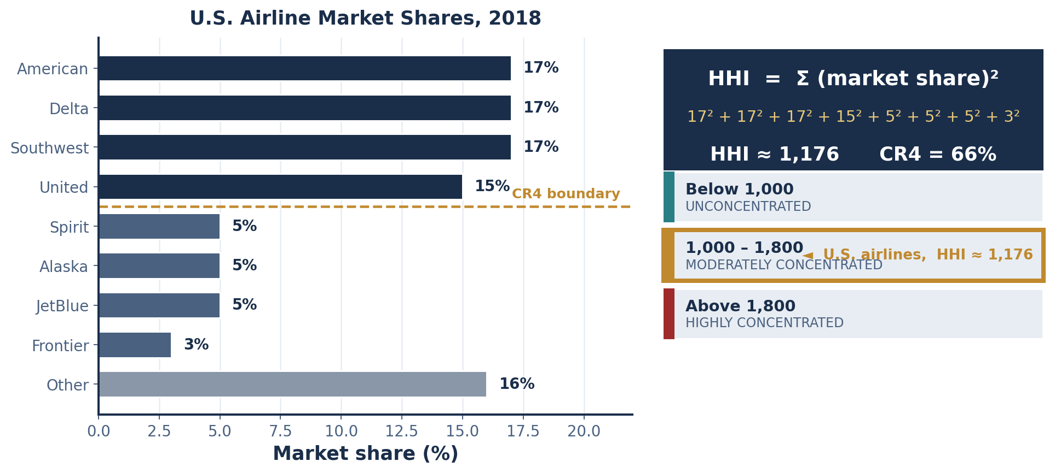
PART 1 · FORMAL DEFINITIONS
Measuring Concentration: CR4 and the HHI
CONCENTRATION RATIO (CR4)
The share of total industry sales held by the FOUR largest firms. Formally, CR4 = s₁ + s₂ + s₃ + s₄, where sᵢ is firm i's percentage share of industry sales. It is simple and intuitive, but it is blind to the DISTRIBUTION of share among the top four: four firms at 25% each and one firm at 85% with three at 5% both yield CR4 = 100%.
HERFINDAHL–HIRSCHMAN INDEX (HHI)
The sum of the SQUARED market shares of every firm in the industry, shares expressed in percentage points. Squaring is what makes the index informative: it weights large firms disproportionately, so the HHI rises when share is concentrated in fewer hands even if the number of firms is unchanged. Range: near 0 (atomistic) to 10,000 (single firm at 100%).
HHI = Σⁿᵢ₌₁ (sᵢ)² CR4 = s₁+s₂+s₃+s₄
sᵢ = firm i's market share in PERCENTAGE POINTS, not decimals
INTRO TO MICROECONOMICS | PROF. VELAZQUEZ
MODULE 11: IMPERFECT COMPETITION & GAME THEORY

Slide 9
PART 1 · DOJ MERGER THRESHOLDS
What the Numbers Trigger
POST-MERGER HHI | CLASSIFICATION | CHANGE IN HHI (ΔHHI) | AGENCY POSTURE
Below 1,000 | UNCONCENTRATED | Any | Ordinarily no further analysis; merger presumed lawful
1,000 – 1,800 | MODERATELY CONCENTRATED | ΔHHI < 100 | Unlikely to have adverse effects; ordinarily cleared
1,000 – 1,800 | MODERATELY CONCENTRATED | ΔHHI ≥ 100 | Raises significant competitive concerns; warrants scrutiny
Above 1,800 | HIGHLY CONCENTRATED | ΔHHI ≥ 100 | PRESUMED to create or enhance market power — the burden shifts to the merging parties to rebut
THE STATUTES
SHERMAN ACT (1890) §1 — bans contracts, combinations and conspiracies in RESTRAINT of trade (price fixing, market allocation, bid rigging).
SHERMAN ACT §2 — bans MONOPOLIZATION: possessing monopoly power PLUS willful acquisition or maintenance of it by exclusionary conduct, as distinct from growth on the merits.
CLAYTON ACT (1914) §7 — bans mergers whose effect 'may be substantially to lessen competition.' This is the prospective statute the HHI implements.
SHERMAN §2 HAS TWO ELEMENTS
Monopoly POWER is not itself illegal. A firm that wins 90% share by building a better product has committed no offense. The violation requires the second element: CONDUCT that excludes rivals from the market by means other than superior efficiency — exclusive dealing, tying, predatory pricing, or paying for default placement.
This is the entire battleground in U.S. v. Google. Both sides concede element one.
ΔHHI = (s₁ + s₂)² − s₁² − s₂² = 2 · s₁ · s₂
The change from a merger depends only on the PRODUCT of the two merging firms' shares
INTRO TO MICROECONOMICS | PROF. VELAZQUEZ
MODULE 11: IMPERFECT COMPETITION & GAME THEORY

Slide 10
SCENARIO · U.S. AIRLINE CONCENTRATION, 2018
Working the HHI
CARRIER | SHARE | SHARE²
American | 17% | 289
Delta | 17% | 289
Southwest | 17% | 289
United | 15% | 225
Spirit | 5% | 25
Alaska | 5% | 25
JetBlue | 5% | 25
Frontier | 3% | 9
HHI (named carriers) | 84% | 1,176
CR4 = 17 + 17 + 17 + 15 = 66% HHI ≈ 1,176
MODERATELY CONCENTRATED under the DOJ thresholds — not a monopoly by the numbers
1
SHOULD DOJ CHALLENGE UNITED + JETBLUE?
2
WHY THE NUMBERS UNDERSTATE THE PROBLEM
United 15% + JetBlue 5% → merged share 20%. ΔHHI = 2 × 15 × 5 = 150. Post-merger HHI = 1,176 − 225 − 25 + 400 = 1,326. The industry stays MODERATELY concentrated, but ΔHHI = 150 ≥ 100 — enough to warrant scrutiny, not enough to trigger the structural presumption.
Airline competition is ROUTE BY ROUTE, not national. A national HHI of 1,176 can conceal a hub where one carrier holds 70% of departures. The relevant antitrust market is the city pair, and on hundreds of city pairs the true HHI exceeds 5,000.
✦1 THE LIMITS OF THE HHI AS A POLICY TOOL
The index measures STRUCTURE (how many firms and how big), not CONDUCT or PERFORMANCE. It cannot see: (i) the wrong geographic market — see block 2; (ii) tacit coordination, which needs no agreement and leaves no evidence; (iii) capacity discipline, where carriers compete on price while jointly restricting seats; (iv) barriers invisible in share data — gate slots, frequent-flyer lock-in, and the sunk cost of a hub. Structure is a PROXY for power. When the proxy and the observed behavior disagree, the behavior is the better evidence.
INTRO TO MICROECONOMICS | PROF. VELAZQUEZ
MODULE 11: IMPERFECT COMPETITION & GAME THEORY

Slide 11
SCENARIO · UNITED STATES V. GOOGLE (2020–2024)
Exclusionary Contracts and the Search Market
90² + 6² + 4(1²) = 8,100 + 36 + 4 = 8,140
3
THE REMEDY AS A SUPPLY-AND-DEMAND PROBLEM
HHI ≈ 8,140 — HIGHLY CONCENTRATED, four times the presumption threshold
Treat DEFAULT SEARCH PLACEMENT as the product. Supply is fixed and vertical — there is exactly one default slot per device, and Apple cannot manufacture a second. Demand comes from search engines, and Google's willingness to pay is the highest because its monetization per query is the highest.
Ban the payments and the price of placement falls to zero. But note what that does NOT do: it reallocates the RENT from Apple back to consumers or to Google; it does not by itself give Bing the query volume it needs. That is the hard part of the remedy.
THE CONDUCT AT ISSUE
Google paid Apple roughly $10–20 billion per year (and additional sums to Mozilla, Samsung and the carriers) to be the DEFAULT search engine. This is an EXCLUSIONARY CONTRACT: it does not forbid a rival from existing, it forecloses the rival's access to DISTRIBUTION.
Google's defense: consumers choose Google because it is better, and switching takes four taps.
DOJ's response: on a new device the consumer never faces the choice at all — the default IS the choice for the overwhelming majority of users.
THE FEEDBACK LOOP THAT MAKES THIS HARD
MORE QUERIES → BETTER RANKING DATA → BETTER RESULTS → MORE USERS → MORE QUERIES. This is a DATA NETWORK EFFECT, and it is self-reinforcing: scale produces quality, and quality produces scale.
The difficulty for antitrust is that the same loop generates both the harm and the consumer benefit. Breaking it up would raise average cost and may degrade the product — the natural-monopoly problem from Module 9. That is precisely why AT&T was REGULATED for 71 years before it was broken up.
It is also, structurally, the Module 8 algorithmic loop: an advantage that compounds because the mechanism that measures merit is itself the mechanism that awards it.
THE KEY LEGAL QUESTION
Not 'does Google have monopoly power?' — the court found that it does. The question is whether default-placement payments are competition ON THE MERITS (Google outbid rivals for a scarce asset) or EXCLUSION (the payments deny rivals the query volume they would need to ever become good enough to compete). Judge Mehta's August 2024 liability ruling adopted the second reading.
INTRO TO MICROECONOMICS | PROF. VELAZQUEZ
MODULE 11: IMPERFECT COMPETITION & GAME THEORY

Slide 12
2
Monopolistic Competition
PART
OBJECTIVE Model the differentiated firm's short-run profit maximization, trace the entry process to the long-run tangency, and derive the excess-capacity result and its welfare interpretation.
INTRO TO MICROECONOMICS | PROF. VELAZQUEZ
MODULE 11: IMPERFECT COMPETITION & GAME THEORY

Slide 13
PART 2 · FORMAL DEFINITION
Monopolistic Competition — The Chamberlin Model
MONOPOLISTIC COMPETITION
A market structure with (1) MANY firms — enough that each ignores the reaction of any individual rival; (2) DIFFERENTIATED products — consumers perceive brands as imperfect substitutes, whether the difference is real or purely perceived; and (3) FREE ENTRY AND EXIT in the long run.
Edward Chamberlin (Harvard, 1933) and Joan Robinson (Cambridge, 1933) developed the model independently and simultaneously — an unusually clean case of parallel discovery in economics.
1
DIFFERENTIATION BUYS A DOWNWARD SLOPE
2
SHORT RUN: PROFIT IS POSSIBLE
3
LONG RUN: ENTRY TAXES IT AWAY
Because Marcus's tacos are not Ray's tacos, Marcus can raise his price by $0.50 and keep MOST of his customers. His firm-level demand curve slopes DOWN — so P > MR, exactly as in monopoly.
Set MR = MC to find q*, read P* up to demand. If P* > ATC(q*), the firm earns positive economic profit. Nothing in this step differs from monopoly.
Profit attracts entrants selling near-substitutes. Each firm's demand curve shifts LEFT and becomes FLATTER. Entry stops only when demand is TANGENT to ATC — that is, when P = ATC and profit = 0.
WHY THE LONG-RUN EQUILIBRIUM MUST BE A TANGENCY
If demand CUT the ATC curve, there would exist some output where P > ATC — positive profit — and entry would continue. If demand lay entirely BELOW ATC, every output would lose money and firms would exit. The only configuration in which no firm wants to enter and none wants to leave is the one where demand TOUCHES ATC at exactly one point. At a point of tangency the two curves share a slope; since ATC is still falling there, its slope is negative, so the tangency occurs on the DOWNWARD-sloping portion of ATC — to the LEFT of minimum ATC. Excess capacity is not an assumption of the model. It is a theorem.
INTRO TO MICROECONOMICS | PROF. VELAZQUEZ
MODULE 11: IMPERFECT COMPETITION & GAME THEORY

Slide 14
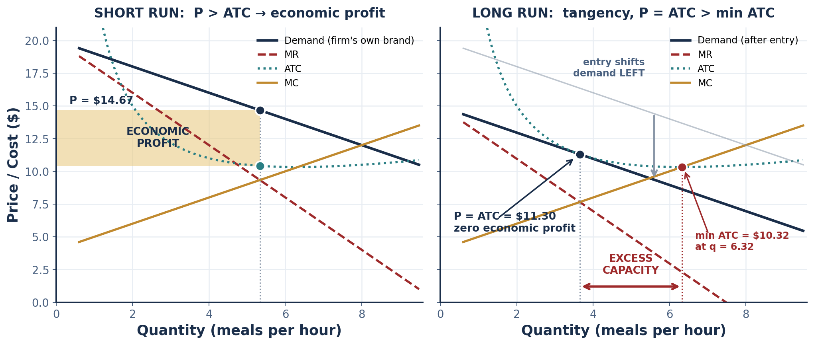
PART 2 · THE DIAGRAM
Short Run and Long Run Side by Side
MR = MC → q*, then read P* UP to DEMAND
THE LONG-RUN CONDITION, STATED TWO WAYS
Identical to monopoly. The difference is what ENTRY does next.
P = ATC (zero profit) AND MR = MC (profit maximizing) simultaneously — which forces demand to be tangent to ATC at q*.
INTRO TO MICROECONOMICS | PROF. VELAZQUEZ
MODULE 11: IMPERFECT COMPETITION & GAME THEORY

Slide 15
PART 2 · THE ALGEBRA
Solving the Tangency Explicitly
TC = 20 + 4q + 0.5q²
MC = 4 + q ATC = 20/q + 4 + 0.5q
EXCESS CAPACITY — FORMAL DEFINITION
The gap between the output at which long-run average total cost is MINIMIZED and the output the monopolistically competitive firm actually produces. Because the tangency occurs on the falling arm of ATC, this gap is strictly positive for every such firm. It is the productive-efficiency cost of variety.
The same quadratic cost family used in Module 9
STEP | WORK | RESULT
Minimum ATC | Set ATC = MC: 20/q + 4 + 0.5q = 4 + q → 20/q = 0.5q → q² = 40 | q = 6.32, min ATC = $10.32
SHORT RUN, demand P = 20 − q | MR = 20 − 2q = 4 + q → 3q = 16 | q* = 5.33, P* = $14.67
Short-run profit | ATC(5.33) = $10.42 → π = (14.67 − 10.42) × 5.33 | π = +$22.65
LONG RUN, demand P = a − q | MR = MC gives a = 4 + 3q, so P = a − q = 4 + 2q. Set P = ATC: 4 + 2q = 20/q + 4 + 0.5q → 1.5q = 20/q → q² = 13.33 | q* = 3.65, P* = ATC = $11.30
Excess capacity | 6.32 − 3.65 | 2.67 units — the firm runs at 58% of its minimum-cost scale
INTRO TO MICROECONOMICS | PROF. VELAZQUEZ
MODULE 11: IMPERFECT COMPETITION & GAME THEORY

Slide 16
SCENARIO · PHILADELPHIA FOOD TRUCK MARKET
Marcus and the Entry Process
1
SHORT RUN
2
THE ENTRY PROCESS
3
THE LONG RUN
Marcus's Oaxacan menu is unlike anything else on the block. His demand curve slopes down; he sets MR = MC and charges P > ATC. He earns positive ECONOMIC profit — a return above what his time and capital would earn in their next-best use.
Positive economic profit is a public signal. New trucks enter with differentiated offerings — Korean, Ethiopian, Nashville hot chicken. Marcus's demand curve shifts LEFT (fewer customers at each price) and becomes FLATTER (closer substitutes now exist).
Entry continues until P = ATC and economic profit is zero. Marcus is not bankrupt — he earns NORMAL profit, the return that just covers opportunity cost. But he now serves fewer customers per hour than his equipment was built for.
WORKSHEET BLANK | ANSWER
Short-run: Marcus earns economic profit because his product is differentiated and P > ______ | ATC — average total cost at his chosen output
Long-run entry process: new trucks enter → Marcus's demand curve shifts ______ | LEFT (and becomes more elastic)
…until P equals: ______ | ATC — zero economic profit, the tangency condition
Excess capacity result: each firm produces ______ the minimum-ATC output, because: ______ | LESS THAN — because the tangency must occur where ATC is still FALLING
✦2 IS VARIETY WORTH THE EFFICIENCY COST?
The variety benefit DOMINATES when consumer tastes are genuinely heterogeneous, when differentiation is real rather than advertised, and when the ATC curve is FLAT near its minimum so excess capacity costs little. It FAILS to dominate when differentiation is purely persuasive (identical products, different packaging), when minimum efficient scale is large so running below it is expensive, and when the resources spent creating perceived difference — advertising, packaging, brand — are themselves a real social cost.
INTRO TO MICROECONOMICS | PROF. VELAZQUEZ
MODULE 11: IMPERFECT COMPETITION & GAME THEORY

Slide 17
SECTION II
Game Theory & Oligopoly
Part 3 · The formal apparatus: normal-form games, dominant strategies, Nash equilibrium, Pareto efficiency
Part 4 · Oligopoly models: Cournot, Bertrand, collusion, kinked demand, price leadership
Part 5 · Constructing and solving normal-form games
Part 6 · Repeated games, cartel stability and the Marcus–Ray strategic interaction

Slide 18
3
Game Theory, Dominant Strategies & Nash Equilibrium
PART
OBJECTIVE Build the formal apparatus of strategic interaction — players, strategies, payoffs — and define, locate and evaluate the Nash equilibrium of a normal-form game.
INTRO TO MICROECONOMICS | PROF. VELAZQUEZ
MODULE 11: IMPERFECT COMPETITION & GAME THEORY

Slide 19
PART 3 · CALLBACK
From Module 7's Upgrading Game to the Formal Model
WHAT YOU DID IN MODULE 7
WHAT WE ADD TODAY
WHY IT MATTERS
The neighborhood upgrading game: each homeowner would gain if all upgraded, but no individual gained by upgrading alone. You reasoned through it INFORMALLY and reached the right conclusion — nobody upgrades.
The apparatus that makes that reasoning MECHANICAL: write the payoff matrix, check each player's best response to each rival strategy, identify dominance, and locate the equilibrium. No intuition required.
Von Neumann and Morgenstern (1944) built the theory; John Nash (1950, two pages in PNAS) proved that every finite game has at least one equilibrium in mixed strategies. That existence proof is why the concept is universal.
ELEMENT | FORMAL DEFINITION | IN THE MARCUS & RAY GAME
PLAYERS | The decision makers, indexed i = 1 … n | Marcus and Ray
STRATEGIES | The complete set of actions available to player i, written Sᵢ | S = {Compete at $8, Accommodate at $12}
STRATEGY PROFILE | One strategy chosen by each player: (s₁, s₂, …, sₙ) | (Compete, Accommodate) is one of four profiles
PAYOFFS | πᵢ(s₁,…,sₙ) — player i's outcome as a function of EVERY player's choice | Monthly profit in dollars, read from the matrix cell
NORMAL FORM | The complete listing of players, strategies and payoffs — the payoff matrix | The 2 × 2 table on the next slide
THE DEFINING ASSUMPTION
Players choose SIMULTANEOUSLY — or, equivalently, without observing the other's choice. Each knows the full payoff matrix. Each is rational and knows the other is rational. This is COMMON KNOWLEDGE of rationality.
INTRO TO MICROECONOMICS | PROF. VELAZQUEZ
MODULE 11: IMPERFECT COMPETITION & GAME THEORY

Slide 20
PART 3 · THE THREE CORE DEFINITIONS
Dominance, Best Response, Nash Equilibrium
DOMINANT STRATEGY
BEST RESPONSE
NASH EQUILIBRIUM
A strategy that yields a player a HIGHER payoff than any alternative, REGARDLESS of what every other player does.
Formally: sᵢ* strictly dominates sᵢ′ if πᵢ(sᵢ*, s₋ᵢ) > πᵢ(sᵢ′, s₋ᵢ) for EVERY s₋ᵢ.
A rational player always plays a dominant strategy when one exists. Most games have none.
The strategy that maximizes player i's payoff GIVEN a particular choice by the others.
Formally: BRᵢ(s₋ᵢ) = argmax πᵢ(sᵢ, s₋ᵢ).
Best response is CONDITIONAL — it depends on what the rival does. A dominant strategy is the special case where the best response is the same for every rival choice.
A strategy profile in which EVERY player is playing a best response to the strategies actually chosen by the others — so no player can gain by unilaterally deviating.
Formally: (s₁*,…,sₙ*) is a NE if for every i, πᵢ(sᵢ*, s₋ᵢ*) ≥ πᵢ(sᵢ, s₋ᵢ*) for all sᵢ ∈ Sᵢ.
PARETO EFFICIENCY
THE SINGLE MOST IMPORTANT RESULT IN THE MODULE
A NASH EQUILIBRIUM NEED NOT BE PARETO EFFICIENT. Individually rational choices can produce a collectively irrational outcome. This is not a failure of the players' reasoning — each is doing exactly the right thing given what the other does. It is a failure of the INSTITUTIONAL STRUCTURE, which offers no way to make a promise binding. The Prisoner's Dilemma is the canonical demonstration.
An outcome is PARETO EFFICIENT if no alternative makes at least one player better off without making another worse off. Outcome A is PARETO SUPERIOR to B if A makes at least one player better off and nobody worse off.
Pareto efficiency is a statement about the SET of outcomes; Nash equilibrium is a statement about individual INCENTIVES. Nothing connects them.
HOW TO FIND A NASH EQUILIBRIUM: for each of the row player's strategies, mark the column player's best reply — then for each column strategy, mark the row player's best reply. Cells with BOTH marks are Nash equilibria.
INTRO TO MICROECONOMICS | PROF. VELAZQUEZ
MODULE 11: IMPERFECT COMPETITION & GAME THEORY

Slide 21
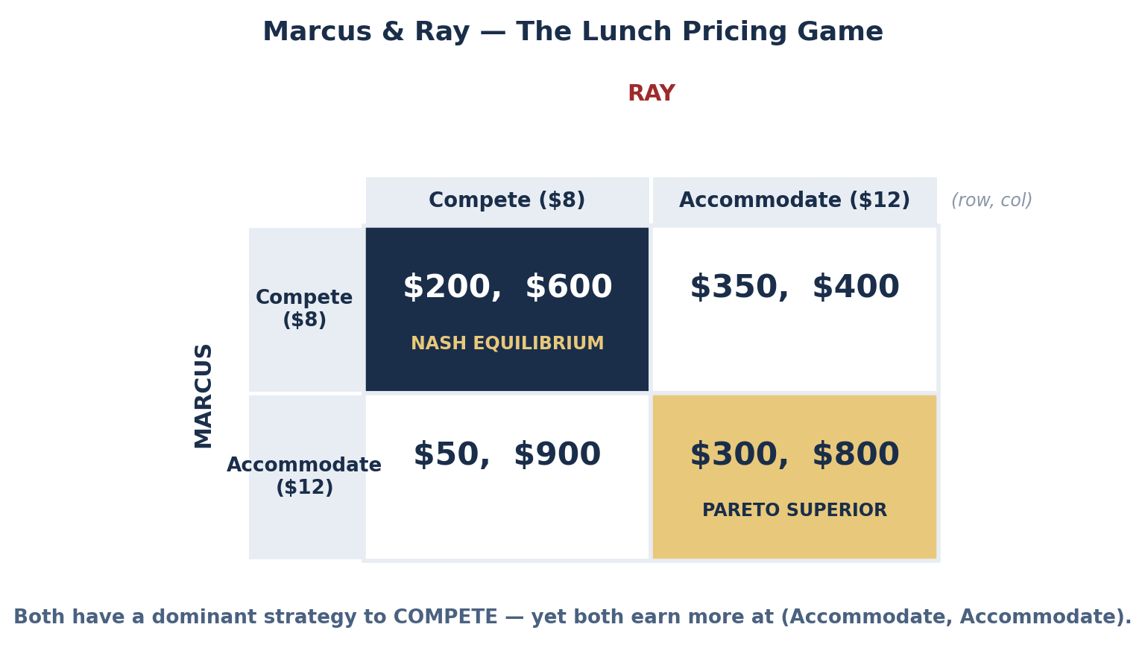
SCENARIO · MARCUS & RAY LUNCH PRICING
A Fully Worked Prisoner's Dilemma
STEP | REASONING | CONCLUSION
Marcus's best reply if Ray COMPETES | $200 (compete) vs. $50 (accommodate) | COMPETE
Marcus's best reply if Ray ACCOMMODATES | $350 (compete) vs. $300 (accommodate) | COMPETE
→ Marcus | Same answer both times | DOMINANT STRATEGY: COMPETE
Ray's best reply if Marcus COMPETES | $600 (compete) vs. $400 (accommodate) | COMPETE
Ray's best reply if Marcus ACCOMMODATES | $900 (compete) vs. $800 (accommodate) | COMPETE
→ Ray | Same answer both times | DOMINANT STRATEGY: COMPETE
NE = (Compete, Compete) = ($200, $600)
Pareto superior: (Accom., Accom.) = ($300, $800)
Both players give up $100 and $200 respectively — and neither can do anything about it alone
SYSTEM 1 VS. SYSTEM 2
Deciding fast (System 1), Marcus might accommodate and hope Ray reciprocates. Deliberate reasoning (System 2) reveals that Ray's dominant strategy makes that hope irrational. In a one-shot game, hope is not a strategy.
INTRO TO MICROECONOMICS | PROF. VELAZQUEZ
MODULE 11: IMPERFECT COMPETITION & GAME THEORY

Slide 22
PART 3 · THE GENERAL STRUCTURE
What Makes a Game a Prisoner's Dilemma
T > C > N > S
WHY THE ORDERING GUARANTEES THE RESULT
Temptation > Cooperation > Nash punishment > Sucker's payoff
T > C means defecting against a cooperator beats cooperating. N > S means defecting against a defector beats cooperating. Together, defection is better in BOTH cases — that is precisely the definition of a dominant strategy.
And C > N means the outcome both players reach by playing their dominant strategies is worse FOR BOTH than the one they rejected. The dilemma is built into the inequality, not into the story.
SYMBOL | NAME | MEANING | MARCUS | OPEC (SA)
T | Temptation | You defect, the other cooperates | $350 | $75B
C | Cooperation | Both cooperate | $300 | $60B
N | Nash | Both defect — the equilibrium | $200 | $45B
S | Sucker | You cooperate, the other defects | $50 | $40B
THE 1950 ORIGIN
Merrill Flood and Melvin Dresher constructed the payoff structure at RAND while studying nuclear deterrence. Albert Tucker supplied the prisoner narrative to make it teachable. The abstraction came first; the story was a teaching device — which is why the same matrix describes arms races, overfishing, doping in sport, and OPEC quotas equally well.
✦3 APPLYING IT TO CLIMATE NEGOTIATIONS — AND WHAT COULD SHIFT THE EQUILIBRIUM
Each country's dominant strategy is to not abate: abatement costs are national and immediate, while the benefit is global and deferred. The four mechanisms that can move a Prisoner's Dilemma to (cooperate, cooperate) are: (1) BINDING ENFORCEMENT — a treaty with real sanctions, which changes the payoffs rather than the reasoning; (2) REPETITION with observable compliance, so defection can be punished later — the Part 6 result; (3) CHANGING THE PAYOFFS DIRECTLY — a carbon price internalizes the externality, so abating becomes individually rational; (4) BORDER ADJUSTMENTS — a tariff on the carbon content of imports converts a foreign country's defection into a domestic-market penalty. The Montreal Protocol on CFCs succeeded largely through (1) and (4); the Paris Agreement relies on (2) alone, which is why compliance is uneven.
INTRO TO MICROECONOMICS | PROF. VELAZQUEZ
MODULE 11: IMPERFECT COMPETITION & GAME THEORY

Slide 23
4
Oligopoly
PART
OBJECTIVE Model strategic interdependence in quantities (Cournot) and prices (Bertrand), locate the cartel outcome and show why it is unstable, and explain price rigidity with the kinked demand curve.
INTRO TO MICROECONOMICS | PROF. VELAZQUEZ
MODULE 11: IMPERFECT COMPETITION & GAME THEORY

Slide 24
PART 4 · FORMAL DEFINITION
Oligopoly and Strategic Interdependence
OLIGOPOLY
TACIT COLLUSION — WHY §1 IS HARD TO ENFORCE
A market in which a SMALL number of large firms account for most of industry sales, protected by significant barriers to entry. The defining feature is not the number itself but its consequence: STRATEGIC INTERDEPENDENCE — each firm's optimal choice depends on what its rivals do, and each knows the rivals are reasoning the same way about it.
This is why oligopoly requires game theory and the other three structures do not.
Sherman §1 requires an AGREEMENT. Parallel pricing alone is not one: if three firms independently conclude that matching the leader is profitable, each has acted unilaterally and lawfully. Prosecutors need 'plus factors' — meetings, signalling, information exchange. This is why price leadership is the durable form of coordination and explicit cartels are the fragile one.
1
COLLUSION / CARTEL
2
KINKED DEMAND CURVE
3
PRICE LEADERSHIP
Firms agree — openly or tacitly — on price or output, and act jointly as a MONOPOLIST. Joint profit is maximized. Illegal per se under Sherman §1 in the U.S.; OPEC operates outside U.S. jurisdiction as a formal cartel of sovereign states.
Raise price → rivals do NOT follow → you lose many customers (elastic). Cut price → rivals DO match → you gain no share (inelastic). Demand kinks at the going price; MR jumps. Result: prices are STICKY.
One DOMINANT firm sets price and the others FOLLOW. It achieves cartel-like coordination without any agreement — and therefore without an agreement to prosecute. General Motors in the 1960s auto industry is the standard example.
THE TWO CLASSICAL MODELS, AND WHY THEY DISAGREE SO VIOLENTLY
COURNOT (Antoine Augustin Cournot, 1838) assumes firms compete by choosing QUANTITY, taking the rival's quantity as given; price then clears the market. BERTRAND (Joseph Bertrand, 1883, in a hostile review of Cournot) assumes firms compete by choosing PRICE, taking the rival's price as given.
With identical products, constant MC and no capacity limits, Bertrand delivers a startling result: TWO firms are enough to drive price all the way to marginal cost, because each can capture the entire market by undercutting by a penny. Cournot instead gives a price strictly between monopoly and competition that falls smoothly as firms are added. The disagreement is the BERTRAND PARADOX, and its resolution — capacity constraints, differentiation, repeated interaction — is most of modern industrial organization.
INTRO TO MICROECONOMICS | PROF. VELAZQUEZ
MODULE 11: IMPERFECT COMPETITION & GAME THEORY

Slide 25
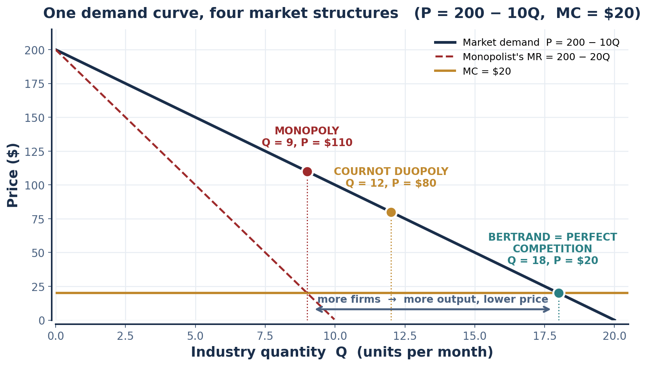
PART 4 · THE COMPETITION LADDER
One Demand Curve, Four Structures
STRUCTURE | Q | P | π (industry)
Monopoly / cartel | 9 | $110 | $810
Cournot duopoly | 12 | $80 | $720
Cournot, 3 firms | 13.5 | $65 | $607.50
Bertrand duopoly | 18 | $20 | $0
Perfect competition | 18 | $20 | $0
Cournot with n firms:
Q = n/(n+1) × Qᶜᵒᵐᵖ
n = 1 gives monopoly; n → ∞ gives competition
READ THE LADDER THIS WAY
Market power is CONTINUOUS, not binary. Each firm added moves the outcome a measurable distance from monopoly toward competition — which is exactly the structural intuition the HHI is trying to capture in a single number.
INTRO TO MICROECONOMICS | PROF. VELAZQUEZ
MODULE 11: IMPERFECT COMPETITION & GAME THEORY

Slide 26
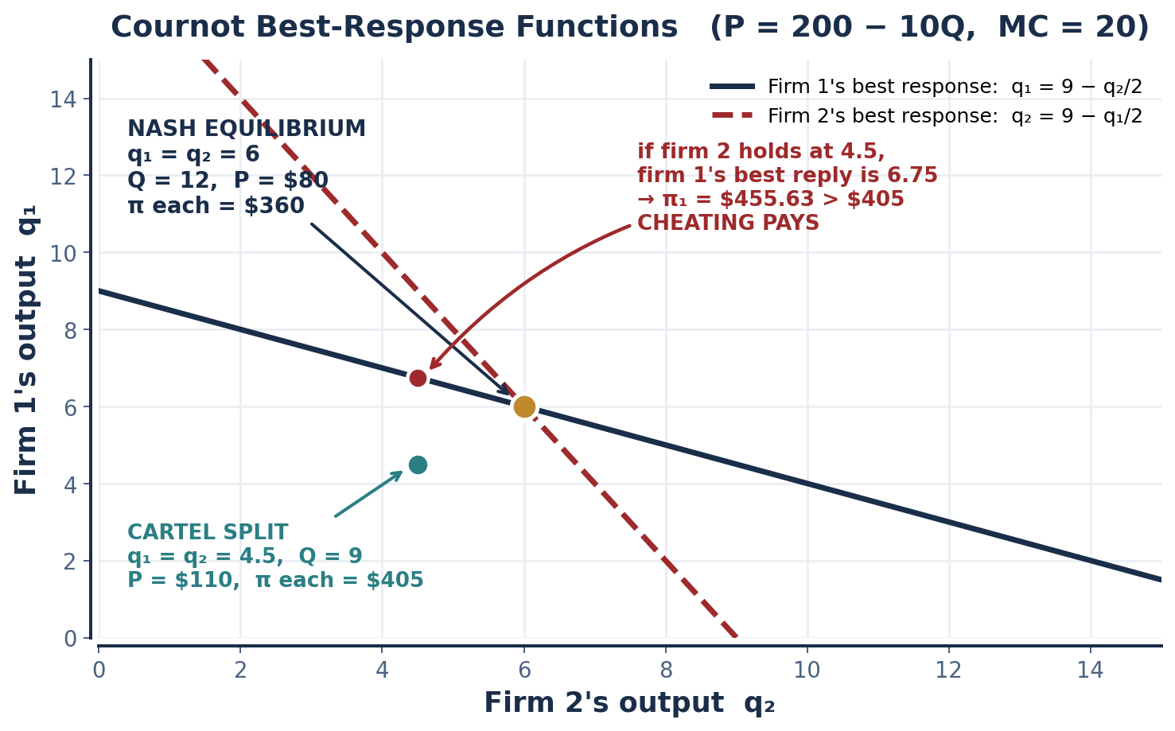
PART 4 · COURNOT WORKED IN FULL
Deriving the Best-Response Function
STEP | WORK
Market demand | P = 200 − 10Q where Q = q₁ + q₂; MC = $20
Firm 1's profit | π₁ = [200 − 10(q₁+q₂)]q₁ − 20q₁
Firm 1's MR | ∂π₁/∂q₁ = 200 − 20q₁ − 10q₂ − 20 = 0
BEST RESPONSE | q₁ = 9 − ½q₂ (and symmetrically for firm 2)
Nash equilibrium | q = 9 − ½q → q* = 6 each, Q = 12, P = $80
Profit each | (80 − 20) × 6 = $360
Cartel comparison | Q = 9, P = $110, split evenly → $405 each
Deviation from cartel | If rival holds at 4.5: q₁ = 9 − 2.25 = 6.75, Q = 11.25, P = $87.50 → π₁ = $455.63
THE CARTEL'S FATAL ARITHMETIC
$455.63 > $405. Holding to the quota is never a best response to the rival holding to the quota. The cartel outcome is NOT a Nash equilibrium of the one-shot game — which is the formal statement of why cartels collapse.
INTRO TO MICROECONOMICS | PROF. VELAZQUEZ
MODULE 11: IMPERFECT COMPETITION & GAME THEORY

Slide 27
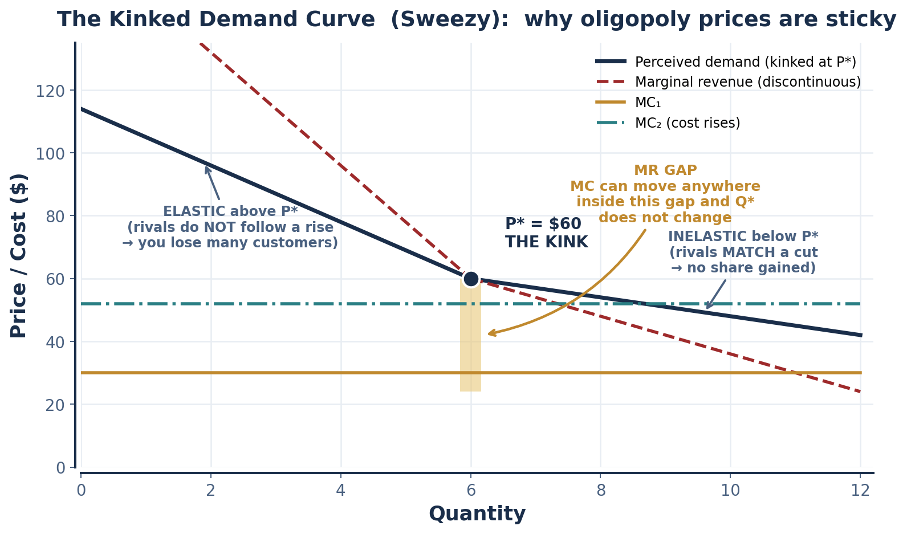
PART 4 · PRICE RIGIDITY
The Kinked Demand Curve (Sweezy, 1939)
THE ASYMMETRIC REACTION ASSUMPTION
The model's whole content is one behavioral assumption: rivals MATCH price cuts but IGNORE price increases.
Both halves are individually rational. Matching a cut protects your share. Ignoring an increase lets you take your rival's customers for free.
THE MR DISCONTINUITY
Two demand segments of different slope produce two MR segments — and a VERTICAL GAP in MR directly below the kink. Marginal cost can shift anywhere within that gap and MR = MC still holds at the same q*.
ITS PREDICTIVE LIMIT
The model EXPLAINS why an established oligopoly price is sticky. It does not explain where that price came from — the kink is located at whatever price already prevails. Stigler (1947) also found that oligopoly prices are not, empirically, notably stickier than others.
INTRO TO MICROECONOMICS | PROF. VELAZQUEZ
MODULE 11: IMPERFECT COMPETITION & GAME THEORY

Slide 28
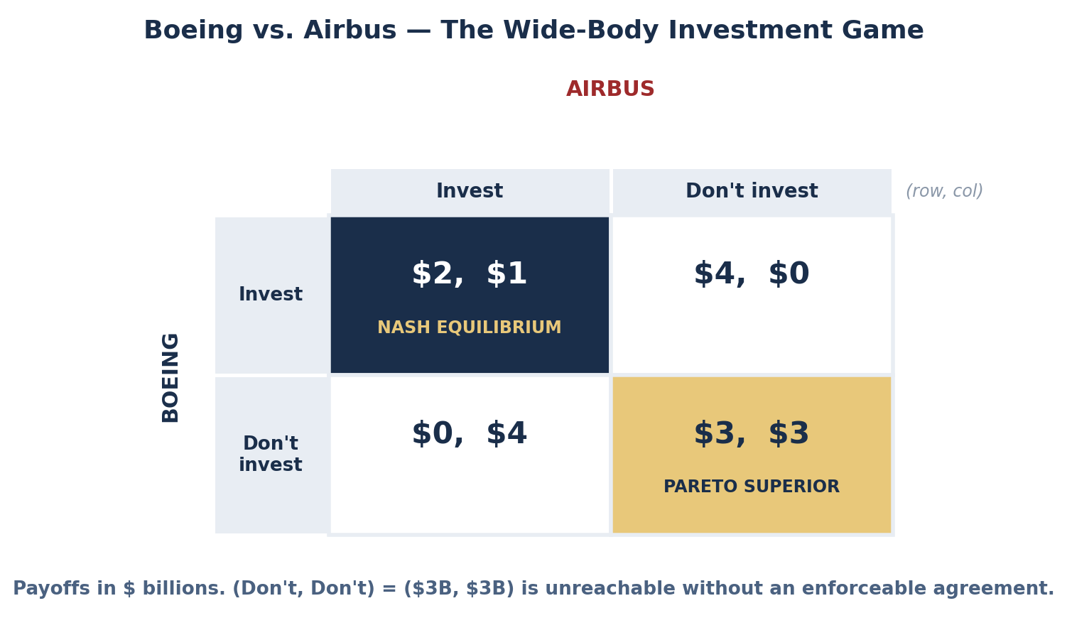
SCENARIO · BOEING VS. AIRBUS, 1990
Investment as a Prisoner's Dilemma
QUESTION | ANSWER
Boeing's dominant strategy | INVEST. If Airbus invests: $2B > $0. If Airbus does not: $4B > $3B. Same answer both times.
Airbus's dominant strategy | INVEST. If Boeing invests: $1B > $0. If Boeing does not: $4B > $3B.
Nash equilibrium | (Invest, Invest) = ($2B, $1B)
Is (Don't, Don't) = ($3B, $3B) achievable? | Pareto superior — joint $6B vs. $3B — but NOT an equilibrium: either firm gains $1B by deviating. It requires a BINDING agreement, which here would be a naked market-allocation conspiracy — per se illegal under Sherman §1 and EU Article 101.
THE KINKED-DEMAND WORKSHEET BLANK
If Ray RAISES price, Marcus does NOT follow — because Marcus profits more by holding his price and absorbing Ray's departing customers. If Ray CUTS price, Marcus MUST follow — because not matching means losing his own customers to Ray. Hence Ray's demand is elastic above the going price and inelastic below it.
WHAT ACTUALLY HAPPENED
Both invested. Boeing launched the 777; Airbus the A330/A340. Both were profitable — but the duopoly's combined return fell far below a single developer's.
INTRO TO MICROECONOMICS | PROF. VELAZQUEZ
MODULE 11: IMPERFECT COMPETITION & GAME THEORY

Slide 29
5
Normal Form Games
PART
OBJECTIVE Construct payoff matrices from economic situations, identify dominant strategies, derive Nash equilibria, and evaluate whether the equilibrium is Pareto efficient.
INTRO TO MICROECONOMICS | PROF. VELAZQUEZ
MODULE 11: IMPERFECT COMPETITION & GAME THEORY

Slide 30
PART 5 · WORKSHEET GAMES 1 AND 2
Two Matrices, Solved Step by Step
GAME 1 — RAY & COMPETITOR PRICING
GAME 2 — WORKERS: STRIKE OR BREAK RANKS
Comp: HIGH Comp: LOW
Ray: PRICE HIGH (40, 40) (5, 60)
Ray: PRICE LOW (60, 5) (20, 20)
Ray if competitor is HIGH: 60 > 40 → LOW. Ray if competitor is LOW: 20 > 5 → LOW.
Ray's dominant strategy: PRICE LOW. By symmetry, the competitor's is also PRICE LOW.
NASH EQUILIBRIUM: (Low, Low), payoffs (20, 20).
B: COOPERATE B: DEFECT
Worker A: COOPERATE (5, 5) (0, 8)
Worker A: DEFECT (8, 0) (2, 2)
A if B cooperates: 8 > 5 → DEFECT. A if B defects: 2 > 0 → DEFECT.
Dominant strategy for each worker: DEFECT (break the strike).
NASH EQUILIBRIUM: (Defect, Defect) = (2, 2). Pareto superior: (Cooperate, Cooperate) = (5, 5).
IS GAME 1'S NE PARETO EFFICIENT?
WHY COLLECTIVE ACTION IS HARD
NO. (High, High) = (40, 40) beats (20, 20) for BOTH. But it is unreachable: from it, either firm gains 20 by cutting to Low. The firms end in a price war neither wanted — and CONSUMERS BENEFIT. Same structure as Marcus–Ray, welfare sign reversed.
Each worker captures the FULL private benefit of breaking ranks, while the cost of a failed strike is spread across everyone. Gains from cooperation are shared; gains from defection are private. Olson (1965): absent selective incentives, large groups under-provide their own common interest.
THE INSTITUTIONS THAT SOLVE GAME 2 | HOW THEY WORK
Union security clauses and closed shops | Make membership a condition of employment — remove the defect option entirely
Strike funds | Raise the sucker payoff S so that cooperating against a defector is survivable
Picket lines and social sanction | Impose a private cost on defection — lower the temptation payoff T
The Wagner Act (1935), §7 and §8(a)(3) | Make employer retaliation against strikers unlawful — changes the payoffs by law, not by agreement
INTRO TO MICROECONOMICS | PROF. VELAZQUEZ
MODULE 11: IMPERFECT COMPETITION & GAME THEORY

Slide 31
PART 5 · GAME 3
Constructing Your Own — The Four-Step Method
1
IDENTIFY THE PLAYERS
2
LIST THE STRATEGIES
3
FILL IN FOUR PAYOFF PAIRS
4
SOLVE IT
Who makes a decision that affects the other's payoff? Two is the workable number. If your 'players' cannot affect each other's outcomes, you have two separate optimization problems, not a game.
The complete set of actions each player can take. Reduce to two per player for a 2 × 2. Label them concretely — 'Enter' / 'Stay out', not 'Strategy A' / 'Strategy B'.
One cell per strategy profile. Order matters: (row player's payoff, column player's payoff). Use real units — dollars, market share, years. The ORDINAL ranking is what drives the result.
Check each player's best reply to each rival strategy. Mark dominance. Any cell where both players are best-replying is a Nash equilibrium. Then ask whether another cell Pareto-dominates it.
CANDIDATE SITUATION | PLAYERS | STRATEGIES | STRUCTURE
Two gas stations on the same corner | Station A, Station B | Match rival's price / Hold high | Prisoner's Dilemma
Two students on a group project | Student 1, Student 2 | Work / Free-ride | Prisoner's Dilemma
Two firms choosing a technical standard | Firm A, Firm B | Standard X / Standard Y | COORDINATION GAME — two Nash equilibria, no dominant strategy
Incumbent vs. potential entrant | Incumbent, Entrant | Fight / Accommodate · Enter / Stay out | SEQUENTIAL — solved by backward induction, not by the matrix
A CAUTION BEFORE YOU WRITE YOUR MATRIX
Not every strategic situation is a Prisoner's Dilemma. If the payoffs do not satisfy T > C > N > S, do not label it one. Coordination games, chicken and stag hunt have different structures and different remedies.
INTRO TO MICROECONOMICS | PROF. VELAZQUEZ
MODULE 11: IMPERFECT COMPETITION & GAME THEORY

Slide 32
YOU TRY
Build and Solve a Game
Pick a strategic situation from your own life or from the news. Do not use one from the table.
Name the two players and give each exactly two clearly labeled strategies.
Fill in all four payoff cells with real units. State what the units are.
Circle each player's best reply to each rival strategy. Identify any dominant strategy.
Locate the Nash equilibrium. Then ask: does any other cell make BOTH players better off?
If yes — you have built a Prisoner's Dilemma. Name one institution that could get the players to the better cell.
12 min
INTRO TO MICROECONOMICS | PROF. VELAZQUEZ

Slide 33
6
Repeated Games, Cartel Stability & Strategic Interaction
PART
OBJECTIVE Show how repeated interaction changes the incentive structure, derive the critical discount factor for grim-trigger cooperation, and apply the result to OPEC and to the Marcus–Ray employment relationship.
INTRO TO MICROECONOMICS | PROF. VELAZQUEZ
MODULE 11: IMPERFECT COMPETITION & GAME THEORY

Slide 34
PART 6 · THE CENTRAL RESULT
Repetition Changes the Incentives, Not the Payoffs
REPEATED GAME
GRIM TRIGGER STRATEGY
The same stage game played over and over by the same players, each of whom observes the full history of past play. Future payoffs are discounted by δ ∈ (0,1) per period — the DISCOUNT FACTOR, which combines time preference with the probability that the relationship continues at all.
A finitely repeated Prisoner's Dilemma with a KNOWN last period unravels by backward induction: defection is dominant in the last round, so it is dominant in the second-to-last, and so on to the first. Cooperation requires that the end never be certain.
'Cooperate in period 1. Cooperate in every period thereafter so long as no player has EVER defected. If anyone defects, defect in every period from then on, forever.'
It is the harshest credible punishment available, which is precisely why it supports cooperation at the lowest discount factor of any strategy. Milder alternatives — TIT-FOR-TAT, which punishes once and forgives — require more patience but are far more robust to mistakes.
COOPERATE: C + δC + δ²C + … = C/(1−δ) DEVIATE: T + δN + δ²N + … = T + δN/(1−δ)
Cooperation is sustainable ⟺ C/(1−δ) ≥ T + δN/(1−δ) ⟺ δ ≥ δ* = (T − C)/(T − N)
The gain from cheating is ONE PERIOD of (T − C). The loss is EVERY FUTURE PERIOD of (C − N). Patience decides which is bigger.
READING THE CONDITION IN WORDS
The gain from cheating is a ONE-TIME bonus of (T − C). The loss is a PERMANENT stream of (C − N), starting next period and discounted by δ. Cooperation survives exactly when the discounted stream outweighs the one-time bonus — which is why the critical value δ* rises with the temptation T and falls with the severity of the punishment (that is, as N drops).
Three things therefore make cooperation easier: PATIENCE (a high δ), a HARSH punishment (a low N), and a SMALL temptation (a low T). Every institutional fix for a cartel, a treaty or an employment relationship works by moving one of those three.
INTRO TO MICROECONOMICS | PROF. VELAZQUEZ
MODULE 11: IMPERFECT COMPETITION & GAME THEORY

Slide 35
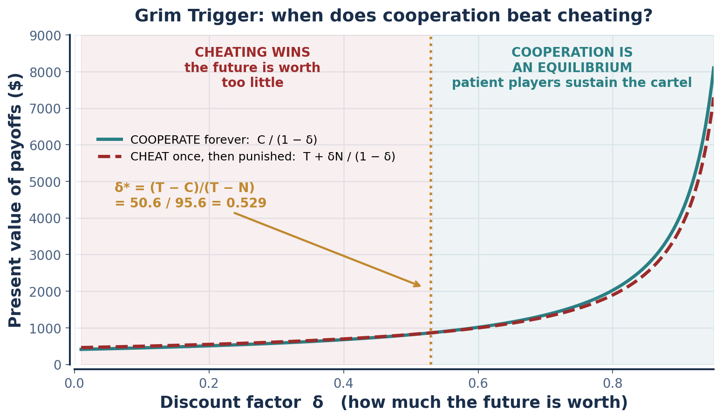
PART 6 · THE CRITICAL DISCOUNT FACTOR
Applying δ* to the Cournot Cartel
APPLY IT TO THE COURNOT CARTEL | VALUE
T — deviate from the quota (q = 6.75 while rival holds 4.5) | $455.63
C — hold the cartel quota (4.5 each) | $405.00
N — Cournot Nash punishment forever (6 each) | $360.00
δ* = (455.63 − 405) / (455.63 − 360) = 50.63 / 95.63 | δ* = 0.529
WHAT δ* = 0.529 MEANS
Each firm must value next period at least 53% as much as this one. Since δ also absorbs the probability that the relationship continues, a cartel with a 40% annual chance of breaking up cannot sustain cooperation at any interest rate.
THE SAME ARITHMETIC, THREE SETTINGS
OPEC (T=75, C=60, N=45): δ* = 0.50. Cournot cartel: δ* = 0.529. Marcus & Ray (T=8, C=5, N=2): δ* = 0.50. The number is always the ratio of the one-period temptation to the total spread between temptation and punishment.
INTRO TO MICROECONOMICS | PROF. VELAZQUEZ
MODULE 11: IMPERFECT COMPETITION & GAME THEORY

Slide 36
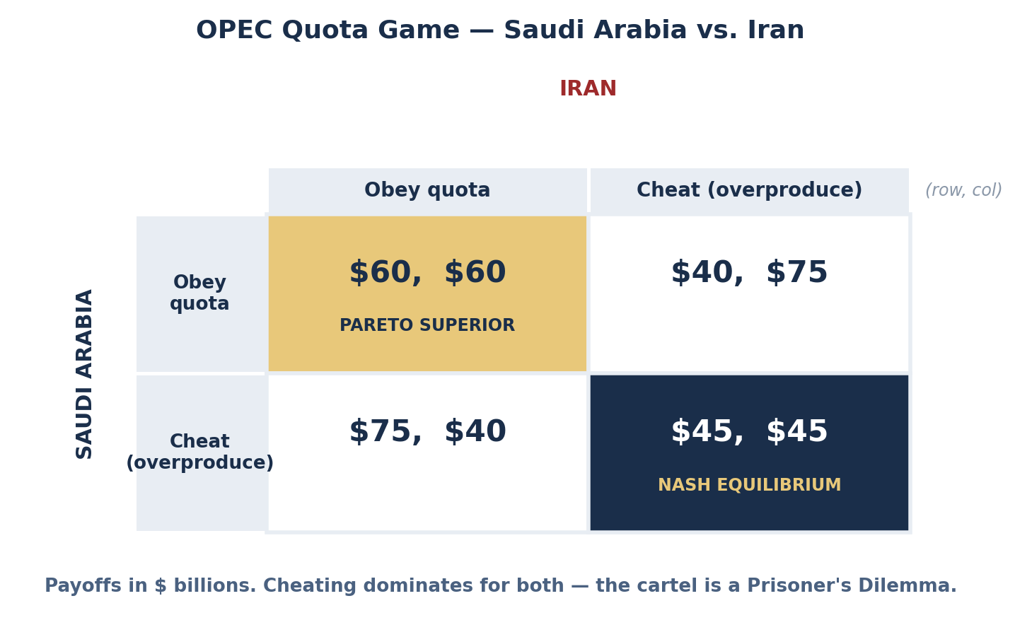
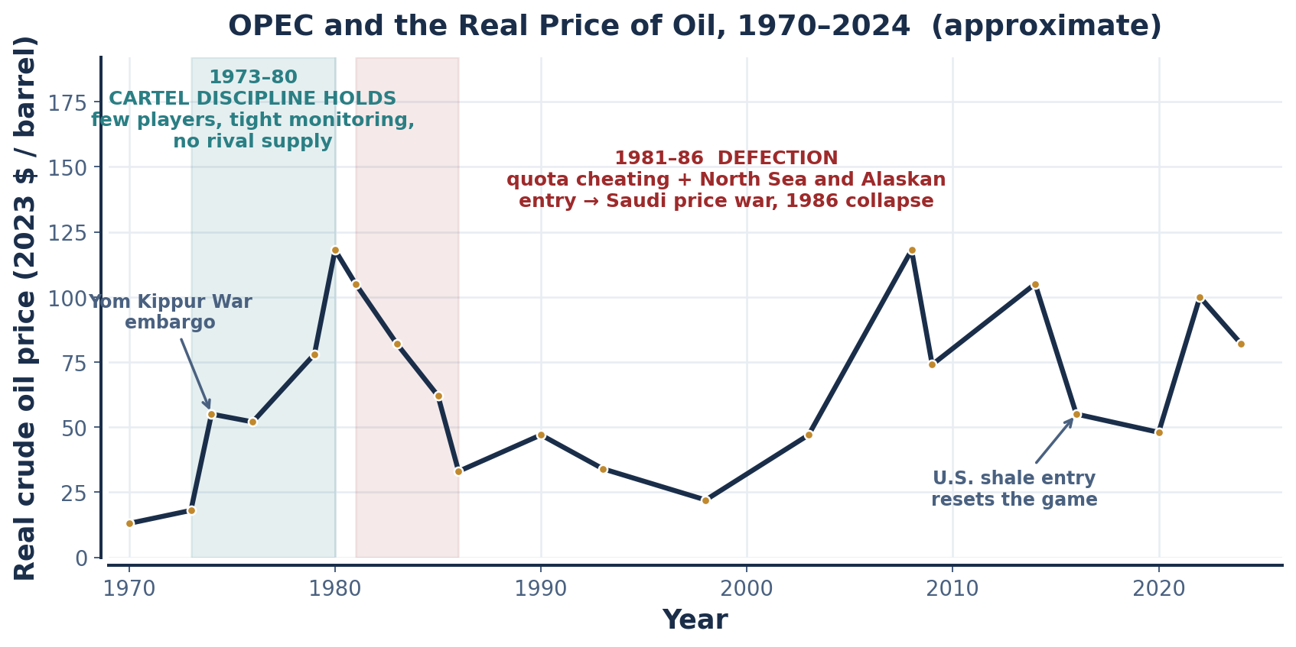
SCENARIO · OPEC CARTEL STABILITY, 1973–PRESENT
The Repeated Game in the Field
WORKSHEET BLANK | ANSWER
One-shot: dominant strategy for each member is to ______ because ______ | CHEAT. Overproducing at the cartel's high price beats obeying regardless of the other's choice: $75B > $60B and $45B > $40B. The Nash equilibrium is (Cheat, Cheat) = ($45B, $45B) — Pareto inferior to (Obey, Obey) = ($60B, $60B).
Repeated: cooperation is sustained if the shadow of the future is ______ | LONG. Members must be patient (δ ≥ δ*), must expect the relationship to continue, and must be able to OBSERVE and RETALIATE against cheating quickly enough that punishment is credible.
Grim trigger sustains cooperation if ______ | δ ≥ (T − C)/(T − N). Applied to the OPEC payoffs: (75 − 60)/(75 − 45) = 15/30 = 0.50. Each member must weight next year at least half as heavily as this one.
Empirical record: OPEC cooperation has been ______ because ______ | UNSTABLE — periods of discipline punctuated by collapse. Quotas are unverifiable, member states have divergent fiscal needs and reserve horizons, and non-OPEC entry repeatedly reset the game.
INTRO TO MICROECONOMICS | PROF. VELAZQUEZ
MODULE 11: IMPERFECT COMPETITION & GAME THEORY

Slide 37
✦4 & ✦5 · OPEC
Why 1973–80 Held and 1981–85 Did Not
GAME-THEORETIC FACTOR | 1973 — COOPERATION EASIER | 1985 — COOPERATION HARDER
NUMBER OF PLAYERS | OPEC held roughly 50% of world production and the Gulf states were the decisive bloc — effectively a small-n game | Non-OPEC supply (North Sea, Alaska, Mexico, USSR) had grown enormously. OPEC's share fell to about 30%, so restraint by members simply ceded market to outsiders
MONITORING | Fewer export routes, fewer buyers, and a small number of long-term contracts made deviation relatively visible | Growth of the SPOT MARKET and secret discounting (freight allowances, quality adjustments, barter deals) made a member's true realized price nearly unverifiable
CREDIBLE PUNISHMENT | Saudi Arabia held large spare capacity and was willing to act as SWING PRODUCER, absorbing cuts to defend the price | Saudi output fell from about 10 mb/d to 3.5 mb/d by 1985 while others cheated. In late 1985 the Saudis abandoned the swing role and flooded the market — punishment finally executed, and the price collapsed from about $62 to $33 in real terms
THE SHADOW OF THE FUTURE (δ) | Post-1973 states expected the cartel and the rents to persist indefinitely — a high effective δ | Debt service, war finance (Iran–Iraq, 1980–88) and internal fiscal crises raised the effective discount rate. An urgent need for cash today lowers δ, and a low δ makes defection rational
✦5 TWO FEATURES THAT SUSTAIN OPEC COOPERATION
TWO FACTORS THAT TRIGGER DEFECTION
(1) An institutional secretariat with regular ministerial conferences — repeated, scheduled, face-to-face interaction raises the perceived δ. (2) Saudi spare capacity: a credible threat to flood the market is the enforcement mechanism the grim trigger requires.
(1) Fiscal shocks — war, debt, or a collapse in state revenue raise the discount rate and make cash today dominate rents tomorrow. (2) Non-member entry — when outsiders can expand supply, restraint transfers profit to rivals rather than to the cartel.
INTRO TO MICROECONOMICS | PROF. VELAZQUEZ
MODULE 11: IMPERFECT COMPETITION & GAME THEORY

Slide 38
SCENARIO · MARCUS & RAY
The Employment Relationship as a Repeated Game
 | MARCUS: HIGH EFFORT | MARCUS: SHIRK
RAY: HONOR the implicit wage agreement | (Ray 5, Marcus 5) — the cooperative equilibrium | (Ray 0, Marcus 8) — Marcus captures the wage without the effort
RAY: EXPLOIT (cut hours without notice) | (Ray 8, Marcus 0) — Ray captures the effort without paying for it | (Ray 2, Marcus 2) — the one-shot Nash equilibrium
WORKSHEET BLANK | ANSWER
One-shot: Ray's dominant strategy = ______ | EXPLOIT (8 > 5 and 2 > 0)
Marcus's best response = ______ | SHIRK (8 > 5 and 2 > 0). NE = (Exploit, Shirk) = (2, 2), Pareto inferior to (5, 5).
Repeated: what sustains the cooperative equilibrium? | The shadow of the future on BOTH sides — Ray's cost of replacing a trained worker, Marcus's cost of a job search, Ray's reputation with the workers he still needs to hire, and the fact that neither knows when the relationship ends.
What breaks it? | A thin labor market (Marcus's threat to leave stops being credible), a high discount rate for Ray, or a known end date — the last month before closing is a one-shot game.
✦6 HOW RAY'S MONOPSONY POWER (MODULE 7) CHANGES THE PREDICTION
Monopsony destroys the symmetry the repeated game depends on. If Ray is the only substantial employer, Marcus's outside option is near zero, so the punishment Marcus can impose — quitting — costs Ray little, while the punishment Ray can impose costs Marcus everything. The cooperative equilibrium collapses toward (Exploit, Shirk), and the shirking is a RATIONAL RESPONSE to an unenforceable wage promise, not a character flaw. The policy interventions that restore balance all work by raising the cost to Ray of the exploit strategy: a binding minimum wage or a wage floor set at VMP, collective bargaining (which converts n one-on-one games into a single game with a player of comparable size), enforceable notice and scheduling laws, portable benefits that decouple health coverage from the employer, and — most directly — a ban on non-compete clauses, which restores the outside option itself.
INTRO TO MICROECONOMICS | PROF. VELAZQUEZ
MODULE 11: IMPERFECT COMPETITION & GAME THEORY

Slide 39
SYNTHESIS
The Whole Module on One Page
QUESTION | PERFECT COMPETITION | MONOPOLISTIC COMPETITION | OLIGOPOLY | MONOPOLY
Does the firm set price? | No — P = MR = MC | Yes, but weakly — P > MR | Yes — and strategically | Yes — P = AR > MR
Long-run economic profit | Zero, at min ATC | Zero, ABOVE min ATC | Positive if barriers hold and coordination survives | Positive if barriers hold
Productively efficient? (P = min ATC) | YES | NO — excess capacity | NO | NO
Allocatively efficient? (P = MC) | YES | NO — P > MC | NO | NO — largest gap
Source of the inefficiency | None | The value consumers place on variety | Strategic restraint of output | Barriers to entry
What tool models it | Supply and demand | The Chamberlin tangency | GAME THEORY | MR = MC with P read off demand
THE THROUGH-LINE FROM MODULE 9 TO HERE
Module 9 gave you COST. Module 10 added REVENUE and produced the rule MR = MC. Module 11 adds the last missing ingredient: OTHER PEOPLE'S CHOICES. Once a firm's optimal action depends on what a rival will do, optimization alone is not enough — you need an equilibrium concept, and the one that works is Nash's.
The deepest lesson is the one that carries into Module 12: individually rational behavior does not aggregate into collectively rational outcomes. That is not a market failure in the usual sense — no one is behaving badly or irrationally. It is a failure of INSTITUTIONS to make promises binding, which is why the remedy is almost always institutional: a contract, a regulator, a repeated relationship, or a change in the payoffs themselves.
INTRO TO MICROECONOMICS | PROF. VELAZQUEZ
MODULE 11: IMPERFECT COMPETITION & GAME THEORY

Slide 40
YOU TRY
Exit Ticket — Module 11
State the Nash equilibrium definition in one sentence, without using the word 'best'.
Explain in two sentences why long-run monopolistic competition has excess capacity.
Compute δ* for a game with T = 100, C = 80, N = 50. Interpret your answer.
Name one real market you believe is an oligopoly and identify its barrier to entry.
Bring the Module 12 Worksheet next session — we take these tools to policy.
5 min
INTRO TO MICROECONOMICS | PROF. VELAZQUEZ

Slide 41
MODULE 11
Sources & Further Reading
Chamberlin, E. H. (1933). The theory of monopolistic competition. Harvard University Press.
Robinson, J. (1933). The economics of imperfect competition. Macmillan.
Cournot, A. A. (1838). Recherches sur les principes mathématiques de la théorie des richesses.
Bertrand, J. (1883). Review of Théorie mathématique de la richesse sociale. Journal des Savants, 67, 499–508.
Sweezy, P. M. (1939). Demand under conditions of oligopoly. Journal of Political Economy, 47(4), 568–573.
Stigler, G. J. (1947). The kinky oligopoly demand curve and rigid prices. Journal of Political Economy, 55(5), 432–449.
von Neumann, J., & Morgenstern, O. (1944). Theory of games and economic behavior. Princeton University Press.
Nash, J. F. (1950). Equilibrium points in n-person games. PNAS, 36(1), 48–49.
Axelrod, R. (1984). The evolution of cooperation. Basic Books.
Olson, M. (1965). The logic of collective action. Harvard University Press.
U.S. Dept. of Justice & FTC. (2023). Merger guidelines.
United States v. Google LLC, No. 1:20-cv-03010 (D.D.C., memorandum opinion, Aug. 5, 2024).
Tirole, J. (1988). The theory of industrial organization. MIT Press, chs. 5–6.
INTRO TO MICROECONOMICS | PROF. VELAZQUEZ
MODULE 11: IMPERFECT COMPETITION & GAME THEORY

